Slide 1
Vigenere Cipher

Slide 2
Introduction
The cipher was first described by Giovan Battisa Bellaso in 1553 .
This Cipher is easy to understand and implement.

Slide 3
Vigenere Cipher
Step 1:Select a Message to Encrypt
Message –”SATISH”
Step 2:Select a Key
Message –”VIT”
Step 3:Expand the Key
S | A | T | I | S | H
V | I | T | V | I | T

Slide 4
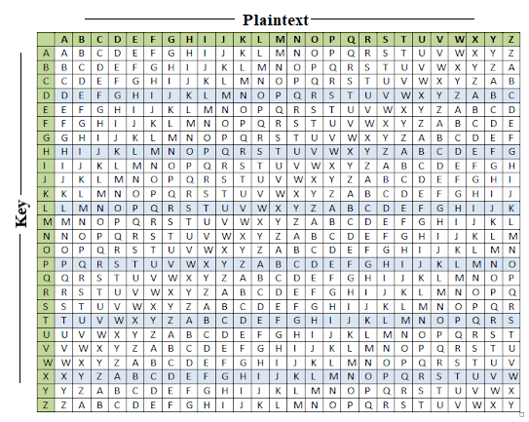
Method-1

Slide 5
Step 4: Encryption
S | A | T | I | S | H
V | I | T | V | I | T
N | I | M | D | A | A
Step 5: Decryption
N | I | M | D | A | A
V | I | T | V | I | T
S | A | T | I | S | H

Slide 6
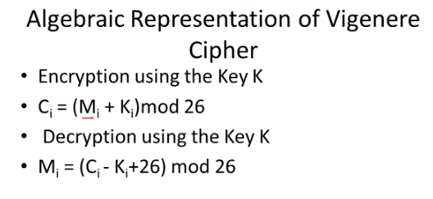


Method-2

Slide 7
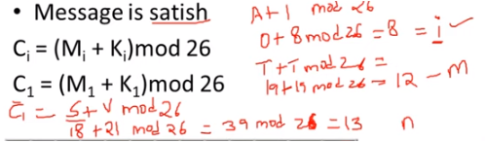
Encryption
S | A | T | I | S | H
V | I | T | V | I | T
N | I | M | D | A | A

Slide 8
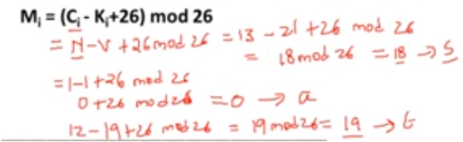
Decryption
N | I | M | D | A | A
V | I | T | V | I | T
S | A | T | I | S | H

